Slide 1
2025 Hackathon
Team 6: Isaac Reaves, Nate Barton, Ethan Wise, & Cameron Hugg

Slide 2

Prompt 1 - LIDAR Roadmap Detection
We used a CNN (Convolutional Neural Network) to train our model and it used 6 different images (4 from the LIDAR Dataset and 2 from the Elevation Dataset). The images were preprocessed to reduce memory usage, by reducing our sample size to only images of 256x256 pixels with roads in them.

Slide 3

Models
Libraries
CNN autoencoder
Unet
TensorFlow
Numpy
Math
Rasterio
SKLearn
PyTorch

Slide 4

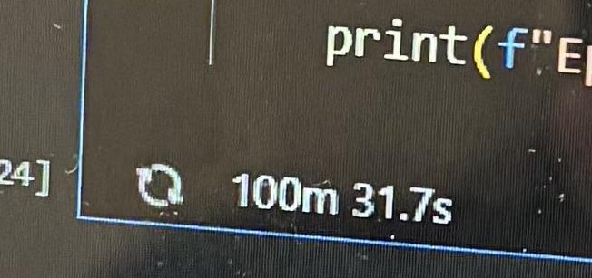
Challenges
AWS environment
Crashing
Too large of data
Too high of resolution
Insane runtimes
Memory management

Slide 5

Innovations
Made our own Notebook with more Gigabytes
Switched environments (PaperSpace)
Eliminated unnecessary parts of the image
Lowered the resolution

Slide 6
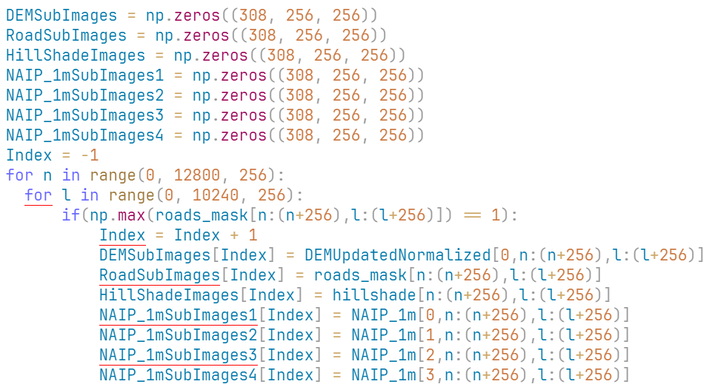
Code Snippets
Normalizes the data
Subsets the image into 256x256 pieces to more easily manage and train the model with

Slide 7
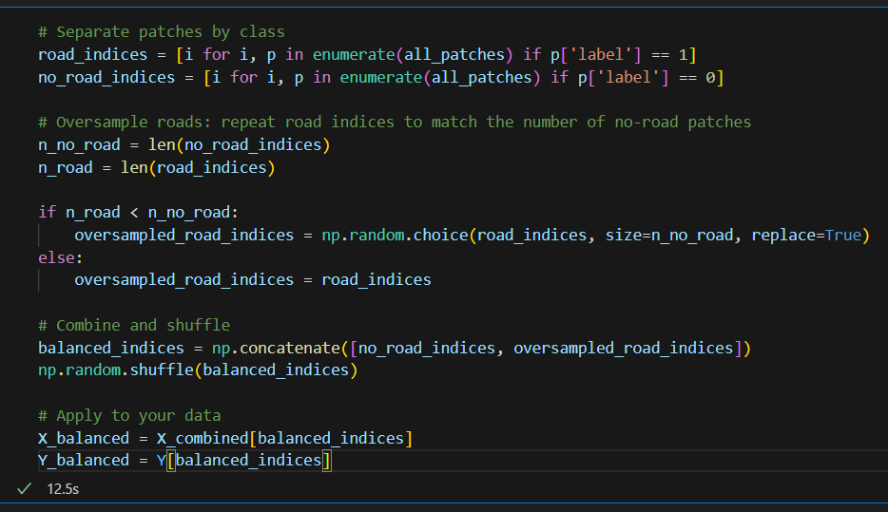
Code Snippets Cont.
Takes our subsetted images and deciphers whether or not the subsetted image contains a road

Slide 8
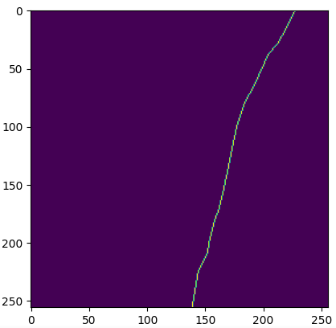
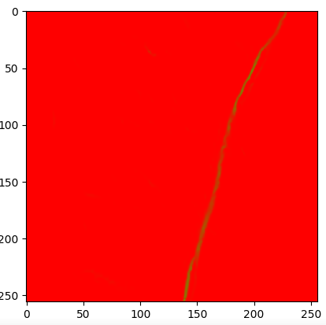
Results

Slide 9
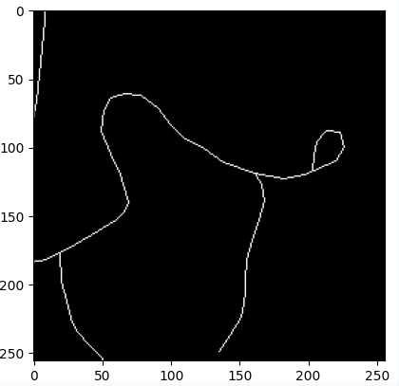
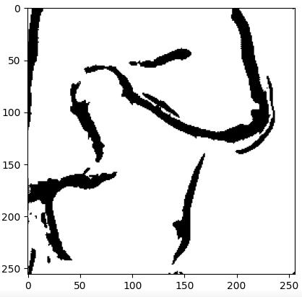
Results

Slide 10
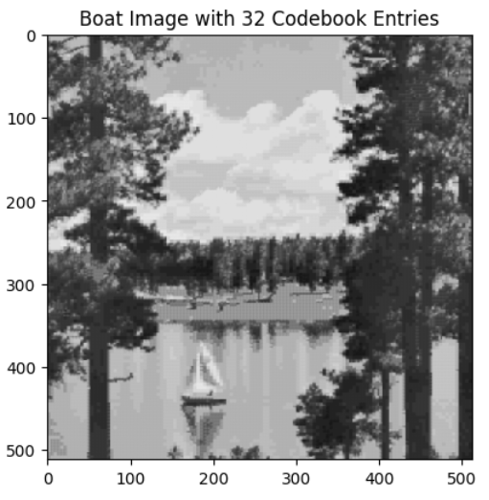
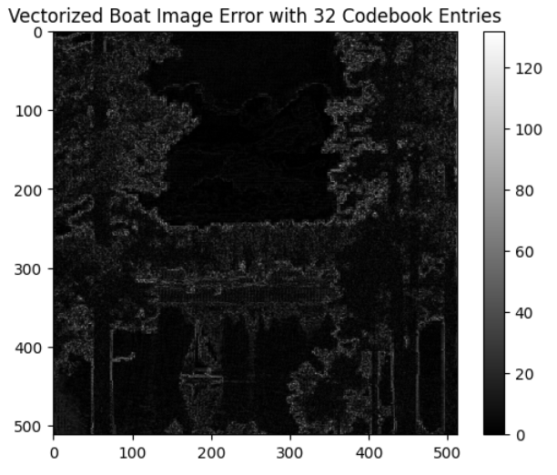
Next Step

Slide 11

Conclusion
What would we have done differently if we got to start over with everything we know now?
Commit to different development environment earlier on
Define a clearer roadmap for work
Focus on getting our model out as soon as possible
Overall, we learned a lot and it was a great experience!

